Slide 1


Predicting Diabetes in the Pima Indian Population
A Machine Learning Approach to Minimizing Missed Diagnoses in High-Risk Groups.
Presented by: Sree Paada Reddy Pallikila

Slide 2
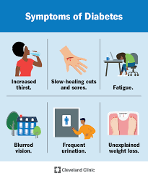
The Public Health Question
Core Question: Can we utilize machine learning to accurately predict diabetes in high-risk populations using standard biometric data, while specifically minimizing missed cases?
•
The Stake: Early detection prevents chronic complications (kidney failure, blindness).
•
The Challenge: Standard screening often misses early-stage insulin resistance.
•
The Critical Error: A False Negative (FN)—telling a sick patient they are healthy—is the most dangerous outcome.
Public Health Context

Slide 3

Literature Review & Context
The Pima Indian Anomaly
The Pima Indians of Arizona have the highest recorded prevalence of Type 2 diabetes in the world.
Previous ML Limitations
Prior studies on this NIDDK dataset faced two main hurdles:
50%
1.
Performance Ceilings: Most models plateau at ~75% accuracy due to sample size (768 records).
of adults over age 35 have diabetes.
2.
Bias: Models consistently favor the majority class (Healthy), leading to dangerously low Recall for diabetic patients.
Literature Review

Slide 4
Data Sources & Variables
Source: National Institute of Diabetes and Digestive and Kidney Diseases (NIDDK).
Variable Type | Examples | Rationale
Predictors (Features) | Glucose, BMI, Insulin, Blood Pressure, Skin Thickness | Standard clinical markers for metabolic syndrome.
Confounders | Age, Pregnancies, Diabetes Pedigree Function | Accounted for by including them as features and scaling data.
Target (Response) | Outcome (0 or 1) | Binary classification: 1 indicates positive diagnosis.

Slide 5
Data Quality Issues
The "Zero" Problem
Biological impossibility: Living patients cannot have 0 Blood Pressure, 0 BMI, or 0 Glucose.
Impact: These zeros act as noise, confusing the model.
The Solution
Median Imputation: We replaced 0s with the median value of non-zero entries for each column. This preserved data distribution better than mean imputation or dropping rows.

Slide 6

Addressing Class Imbalance
The Bias Problem
Original Split: 65% Healthy / 35% Diabetic.
Models are "lazy"—they achieve high accuracy by simply predicting "Healthy" for everyone, missing actual cases.
The Fix: SMOTE
Synthetic Minority Over-sampling Technique:
We generated synthetic examples of diabetic patients in the training set. This forces the model to learn the characteristics of diabetes rather than just guessing the majority class.

Slide 7

The Breakthrough: Feature Engineering
Raw data wasn't enough to break the 75% accuracy ceiling. We created two new medically relevant features that became critical predictors.
1. Insulin Resistance Index
2. High Risk Combo
Glucose / Insulin
IF (BMI > 30 AND Age > 40)
Captures the body's struggle to utilize insulin, a clearer marker of Type 2 Diabetes than either variable alone.
A binary flag identifying the highest-risk demographic group based on literature.

Slide 8



Model Selection Strategy
We tested three distinct algorithms to find the optimal balance between Accuracy and Safety.
Logistic Regression
Random Forest
XGBoost + FE
The Baseline. Simple and interpretable, but failed to capture complex non-linear relationships.
The Safety Net. Excellent at Recall. It captured the most cases but had lower overall accuracy (more false alarms).
The Champion. Gradient boosting combined with our new features provided the best stability and safety.
Result: 27 Missed Cases
Result: 14 Missed Cases
Result: 11 Missed Cases

Slide 9
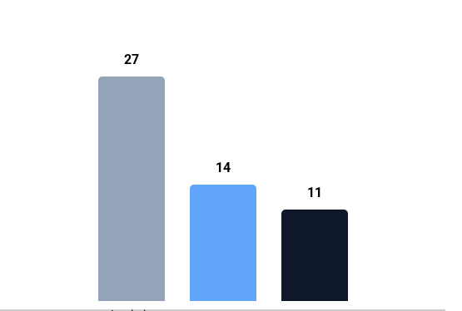
Results: The Safety Leap
Reduction in False Negatives
Why this matters
Metric | Baseline | Final Model | Improvement
Accuracy | 69.5% | 74.7% | +5.2%
Recall | 50.0% | 79.6% | +29.6%
Missed Cases | 27 | 11 | -59%
We reduced the critical error rate by nearly 60%.

Slide 10
Critical Evaluation
Strengths
Limitations & Future Work
•
Safety First: Prioritized Recall over Precision. It is better to flag a healthy person (False Positive) than miss a sick one.
•
The Performance Ceiling: Despite advanced tuning, Accuracy capped at ~75%. This suggests the dataset lacks variables (e.g., genetic markers, diet logs) needed for higher precision.
•
Interpretability: Engineered features align with medical literature (Insulin Resistance).
•
Sample Size: 768 records is small for deep learning.
•
Robustness: Cross-validation ensures results aren't a fluke.
•
Future: External validation on non-Pima datasets is needed.

Slide 11


Conclusion
By moving beyond simple accuracy and focusing on feature engineering and class balancing, we developed a model that is clinically viable.
Impact: For every 100 diabetic patients screened, our model identifies 30 more patients than the baseline model.
This translates directly to earlier intervention and better long-term health outcomes for the Pima community.

Slide 12
Q & A
Thank you for your attention.

Slide 13





Image Sources
https://pub.mdpi-res.com/nanomaterials/nanomaterials-15-00895/article_deploy/html/images/nanomaterials-15-00895-ag-550.jpg?1749626317
Source: www.mdpi.com
https://www.hopkinsmedicine.org/-/media/images/health/1_-conditions/diabetes/diabetesinfographic.jpg
Source: www.hopkinsmedicine.org
https://i.ytimg.com/vi/3Gnm6b9WxbY/maxresdefault.jpg
Source: www.youtube.com
https://miro.medium.com/1*wpmPLh2zRCKfvVh5J4hv9Q.png
Source: medium.com
https://mlcmedicalconsulting.com/wp-content/uploads/2022/12/iStock-1373659740.jpg
Source: mlcmedicalconsulting.com

